Slide 1
Python for Machine Learning
UE19EC353
Department of ECE

Slide 2
Introduction to Data

Slide 3
Importance of Data
To truly understand how ML works, what type of ML algo to apply, we need to understand the data
Data refers to : examples or cases from the domain that characterize the problem you want to solve.
Anything can be expressed in terms of DATA.
Understanding types of data : EDA and Data Engineering

Slide 4
Types of Data
DATA
Numerical
Categorical
Time Series
Text
Continuous
Discrete

Slide 5
Numerical Data
any data where data points are exact numbers
any form of measurable data
Discrete : Exact or whole numbers i.e Distinct Values
Continuous : any value within a range
Note : Numerical data is not tied to any specific point in time, they are simply raw numbers

Slide 6
Categorical Data
Represents characteristics
It is non-numerical, meaning you are unable to add them together, average them out, or sort them in any chronological order.
for grouping
in classification, categorical data would be the class label
Eg : gender, social class, ethnicity
Ordinal data: categories are ordered or ranked in some particular way. Eg: Beginner, Intermediate, Advanced

Slide 7
Time Series Data and Text Data
Sequence of numbers collected at regular intervals over some period of time
Has established starting and ending points in terms of time
Data over weeks, hours, years, etc
Words, sentences, or paragraphs
Most often grouped together or analyzed using various methods such as word frequency, text classification, or sentiment analysis

Slide 8
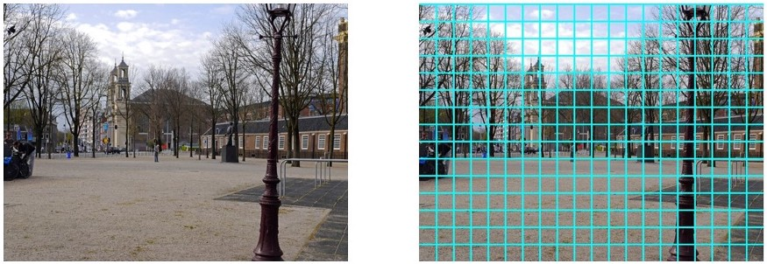
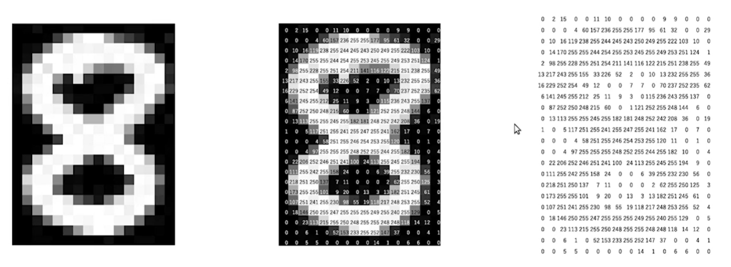
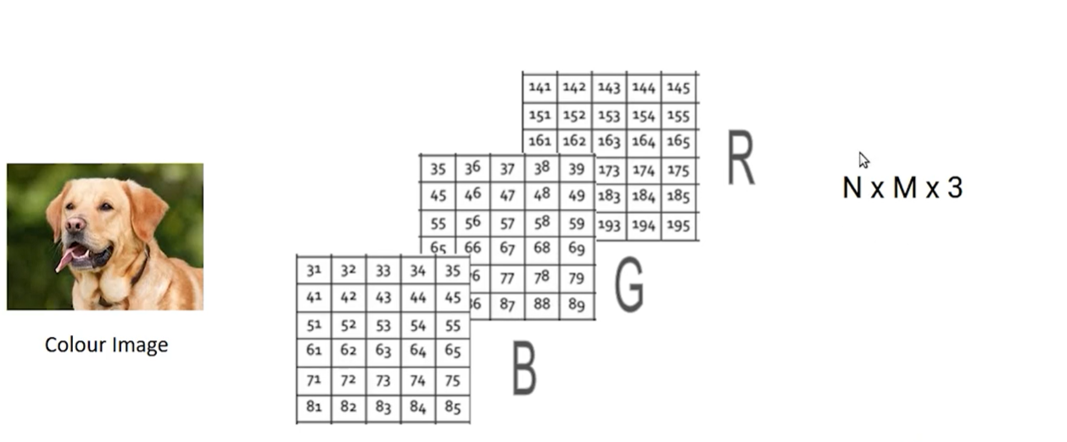
Image Data
Image Credits to Medium posts

Slide 9
Importance of Visualization

Slide 10
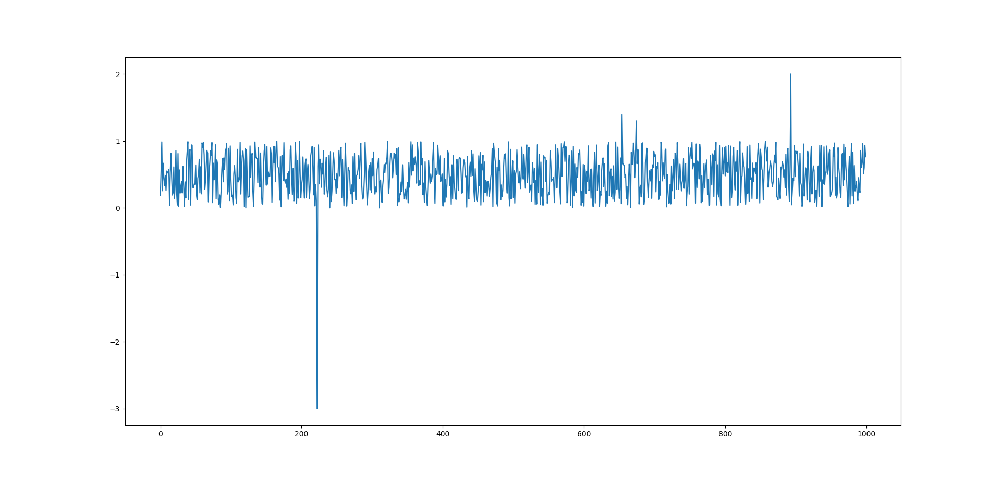

Slide 11
Why Visualization?
Data will be transformed into some form of plots and analyzed further from that.
grasp a lot of info from diagrammatic representation than the counterparts.
Identify any main pattern
Identify any anomalies
Understand the distribution of data

Slide 12
Acknowledgments
https://jakevdp.github.io/PythonDataScienceHandbook/
Introduction to Scientific Computing (UCSB)
J.R. Johansson’s Notebooks

